Slide 1

Machine Learning and Data Mining
Lecture 2.2: Basis Functions, Regularization, and Logistic Regression

Slide 2
What best summarizes your current relationship with homework one?
I’ve finished either the math part or the programming part (or both)
I’ve read over it and think I know how to proceed with the work
I haven’t really looked at it yet
I’ve read over it and have no idea where to even begin with some questions

Slide 4
Your First Probabilistic Learning Algorithm: MLE
The intuitive answer is that 3/5 “fits the data” the best. We’ll formalize that notion this lecture.
Maximum Likelihood Estimation – Find parameters that make the observed data most likely.
Assume a probabilistic model of how the data was generated $x∼P(x;θ)$ parameterized by some set of parameters $θ$
Find ${\hat{θ}}_{MLE}$ that maximizes the probability (or likelihood) of generating the training data under the probabilistic model.
Why MLE?
Often leads to “natural” or intuitive parameter estimates
MLE is optimal if model class is correct (e.g. Normal model for normally distributed data)

Slide 5

Your Second Statistical Learning Algorithm: MAP
Maximum A Posteriori – Find parameters that make the observed data most likely but consider a prior over the parameters.
Assume a prior distribution over $θ, P(θ)$
Assume a probabilistic model of how the data is generated: -- parameter $θ∼P(θ)$ and then data $x∼P(x|θ)$
Find ${\hat{θ}}_{MAP}$ that maximize the posterior $P\left(θ | D\right)∝P\left(D | θ\right)P(θ)$
$$P\left(θ | D\right)=\frac{P\left(D | θ\right)P(θ)}{P(D)}$$
Why MAP?
Rigorous framework to combine observations (likelihood) with beliefs (prior)

Slide 6
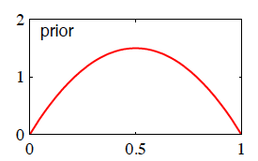
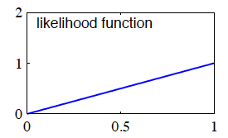
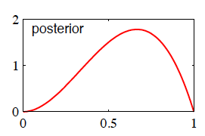
Effect of Prior on Coin Flip
Prior = Beta(2,2)
θ_{prior} = 0.5
Dataset = {H}
L(θ) = θ
θ_{MLE} = 1
Posterior = Beta(3,2)
θ_{MAP} = (3-1)/(3+2-2) = 2/3

Slide 7
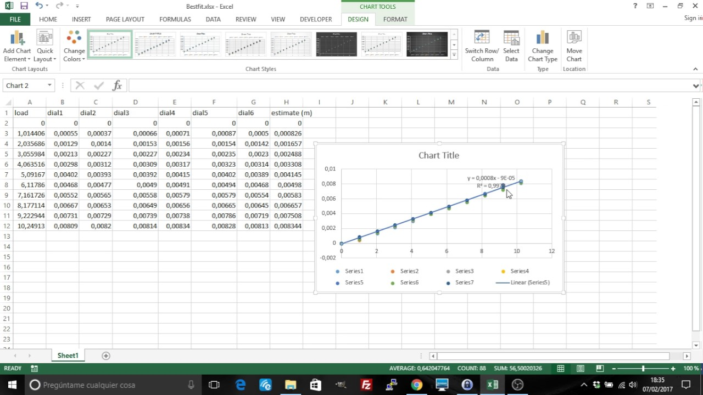
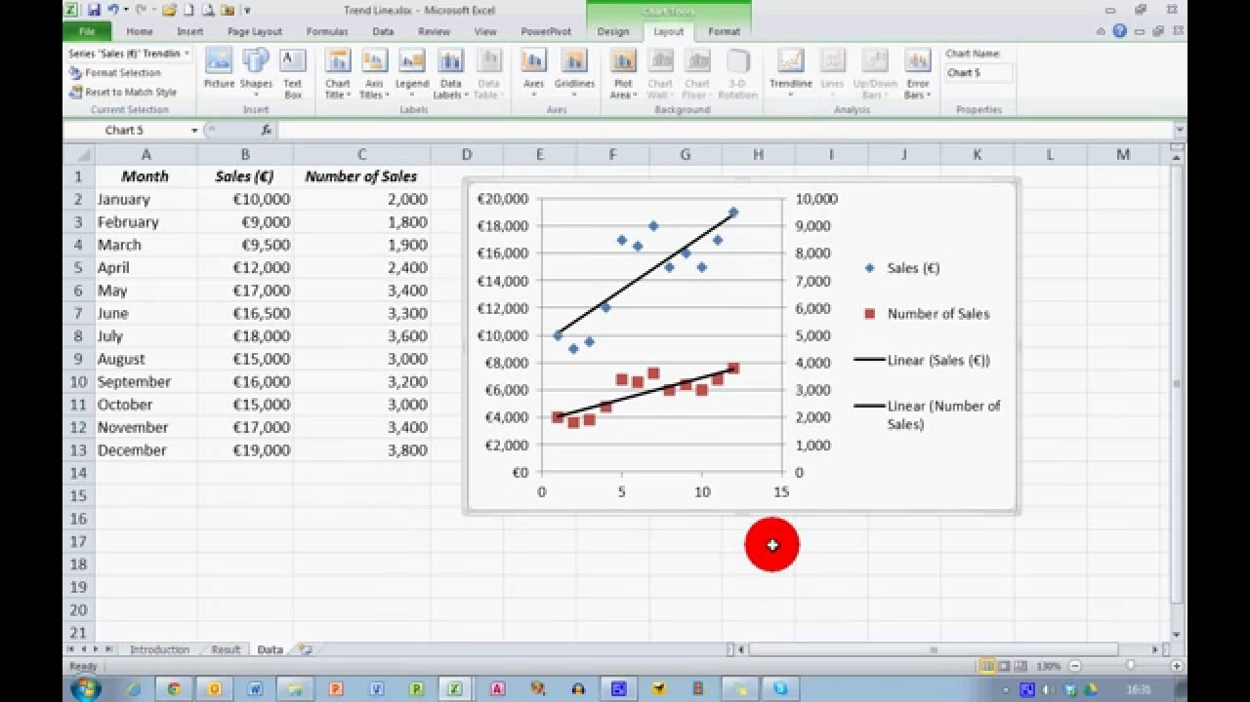
Linear Regression
Regression → We are predicting some continuous output y
Linear → We assume there is a linear relationship between input x and output y

Slide 8
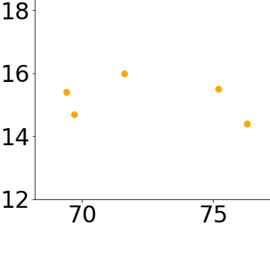
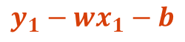
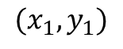
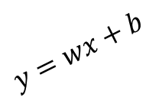
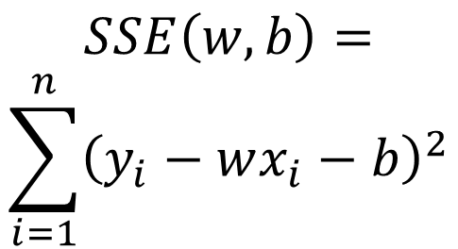
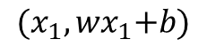
Visualizing Sum of Squared Error
$${(x_{1}, wx}_{1}+b)$$
$$SSE\left(w,b\right)= \\ \sum_{i=1}^{n}{{\left(y_{i}−wx_{i}−b\right)}^{2}}$$
$$y=wx+b$$
$$y_{1}−{wx}_{1}−b$$
$$(x_{1},y_{1})$$
Data from: The Song of Insects by Dr.G.W. Pierce, Harvard College Press

Slide 9
Multidimensional Linear Regression
1) Matrix/vector computation of sum of squared errors:
$$SSE\left(w\right)={\left(y−Xw\right)}^{T}(y−Xw)$$
2) Set equal to zero vector and solve:
$$2X^{T}\left(y−Xw\right)=\vec{0}$$
$$⟹X^{T}Xw=X^{T}y$$
$$⟹w^{∗}={\left(X^{T}X\right)}^{−1}X^{T}y$$

Slide 10
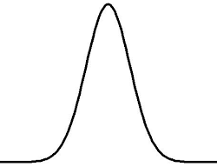
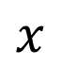
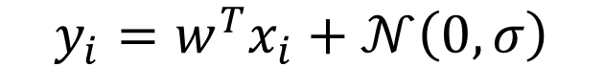
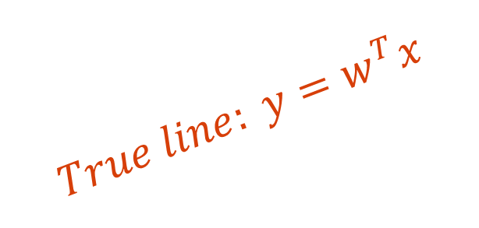
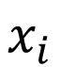
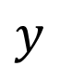
Let’s view this from a different angle
Our “generative story” for this data:
$$y_{i}=w^{T}x_{i}+𝒩\left(0,σ\right)$$
$$y$$
$$True line: y=w^{T}x$$
$$x$$
$$x_{i}$$

Slide 11

Let’s view this from a different angle
Okay. Still not seeing why we care? Let’s start doing MLE.
Dataset: Given a dataset $D={\left\{(x_{i},y_{i})\right\}}_{i=1}^{N}$ assume the above conditional probability.
Model assumption:
$$y_{i}=w^{T}x_{i}+𝒩\left(0,σ\right) ⟹P\left(y_{i} | x_{i}, w\right)=𝒩\left(w^{T}x_{i},σ\right)$$
Write out likelihood of the training data as a function of parameters $θ$:
$$𝓛\left(θ\right)=P\left(D∣θ\right)=\prod_{i=1}^{N}{P\left(y_{i} ∣ w\right)=\prod_{i=1}^{N}{\frac{1}{σ\sqrt{2π}}e^{−\frac{{\left(y_{i}−w^{T}x_{i}\right)}^{2}}{2σ^{2}}}}}$$
Yikes. Let’s apply a log and write the log-likelihood to clean this up:
$$𝓛𝓛\left(θ\right)=P\left(D∣θ\right)=N\log\left(\frac{1}{σ\sqrt{2π}}\right)−\frac{1}{2σ^{2}}\sum_{i=1}^{N}{{\left(y_{i}−w^{T}x_{i}\right)}^{2}}$$

Slide 12

Let’s view this from a different angle
Wait… this part is looking familiar...
$$𝓛𝓛\left(θ\right)=N\log\left(\frac{1}{σ\sqrt{2π}}\right)−\frac{1}{2σ^{2}}\sum_{i=1}^{N}{{\left(y_{i}−w^{T}x_{i}\right)}^{2}}$$
How do we maximize this log-likelihood with respect to w?
Find $w^{∗}$ such that $\sum_{i=1}^{N}{{\left(y_{i}−w^{T}x_{i}\right)}^{2}}$ is as small as possible
AKA find weights that minimize the sum of squared error!
Linear regression is just MLE of a linear model with Gaussian noise!

Slide 13
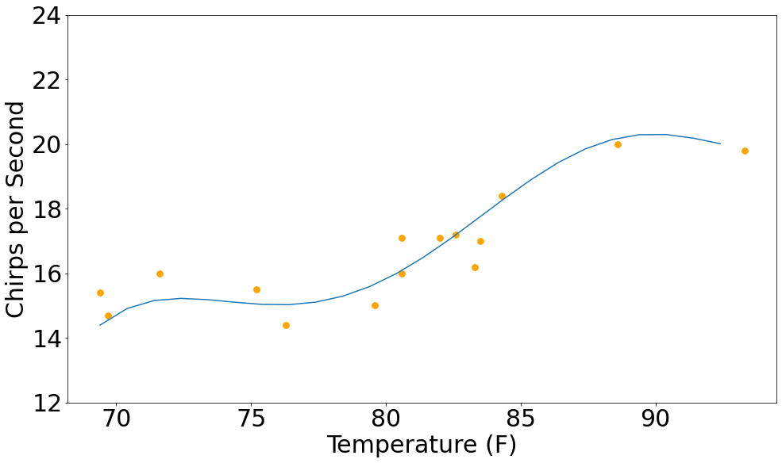
Teaser
You: It’s just fitting straight lines. Boring.
Me: I fit this with least-squares linear regression too. Tune in next time.

Slide 14
Be able to answer:
Wrapping up a few details about OLS.
How can we use least-squares regression to fit more complex functions?
What is polynomial regression?
More generally, how can we learn linear functions over basis functions?
What is regularization?
What is logistic regression?

Slide 15
A Note on Nomenclature
Last time we were talking about linear regression and proposed the objective:
$$SSE\left(w\right)={\left(y−Xw\right)}^{T}(y−Xw)$$
This is often referred to as “ordinary least squares” or OLS regression. Usually when someone says “linear regression” this is what they mean.

Slide 16
Invertibility of $X^{T}X$
Solution to Ordinary Least Squares (OLS) where X is a n-by-d data matrix:
$$w^{∗}={\left(X^{T}X\right)}^{−1}X^{T}y$$
Problem: Is $X^{T}X$ always invertible? Nope. To be invertible, matrix must be full rank (i.e., have no linearly dependent columns).
$$Rank\left(X^{T}X\right)=Rank(X)$$
If X is full rank, then $X^{T}X$ is too.
If n < d then Rank(X^{T}X) < d.
If I have fewer data points than dimensions, no inverse.
$$Rank\left(X^{T}X\right)=Rank\left(X\right)≤min(n,d)$$

Slide 17

Invertibility of $X^{T}X$
Solution to Ordinary Least Squares (OLS) where X is a n-by-d data matrix:
$$w^{∗}={\left(X^{T}X\right)}^{−1}X^{T}y$$
Moore-Penrose Psuedo-Inverse $X^{+}$
Moore-Penrose Pseudo-Inverse is always defined and exactly equal to the above when X has full rank. Still the correct solution otherwise (proof)
$$w^{∗}=X^{+}y$$
The Psuedo-Inverse solution tends to be more stable in general to compute.
In numpy: numpy.linalg.pinv(X)

Slide 18
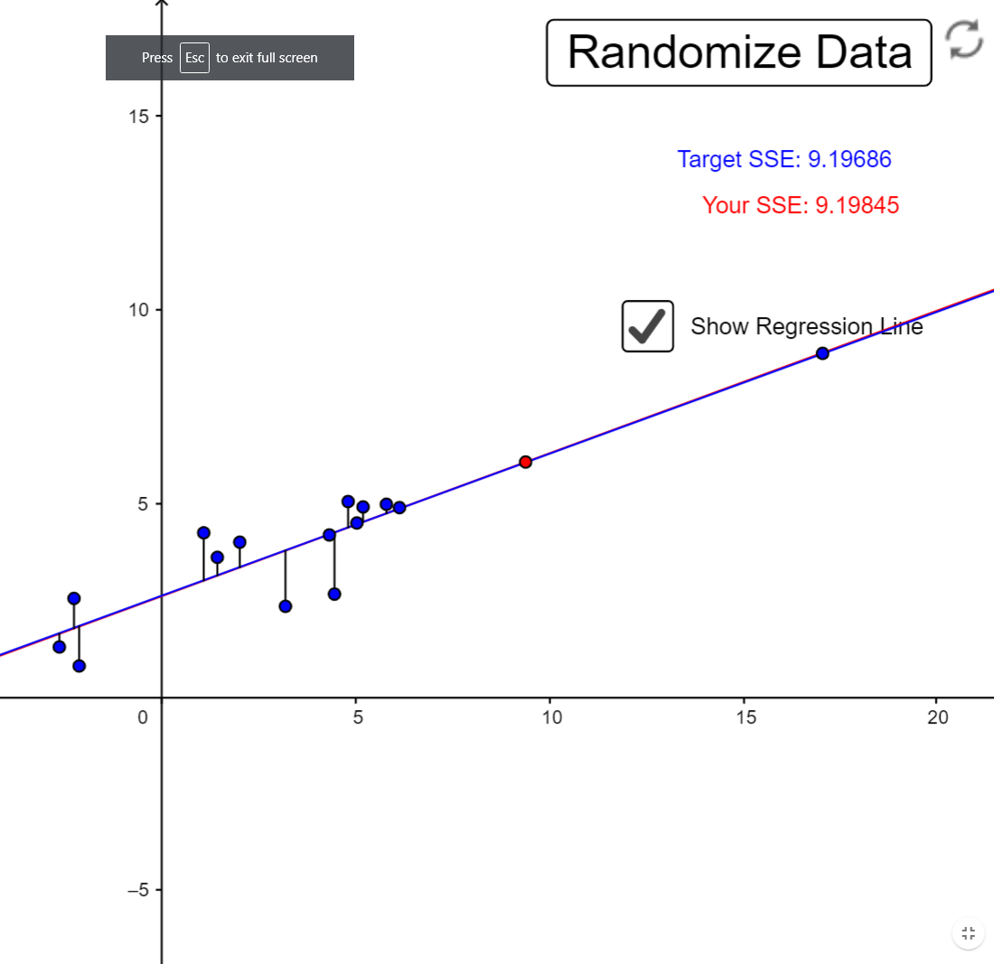
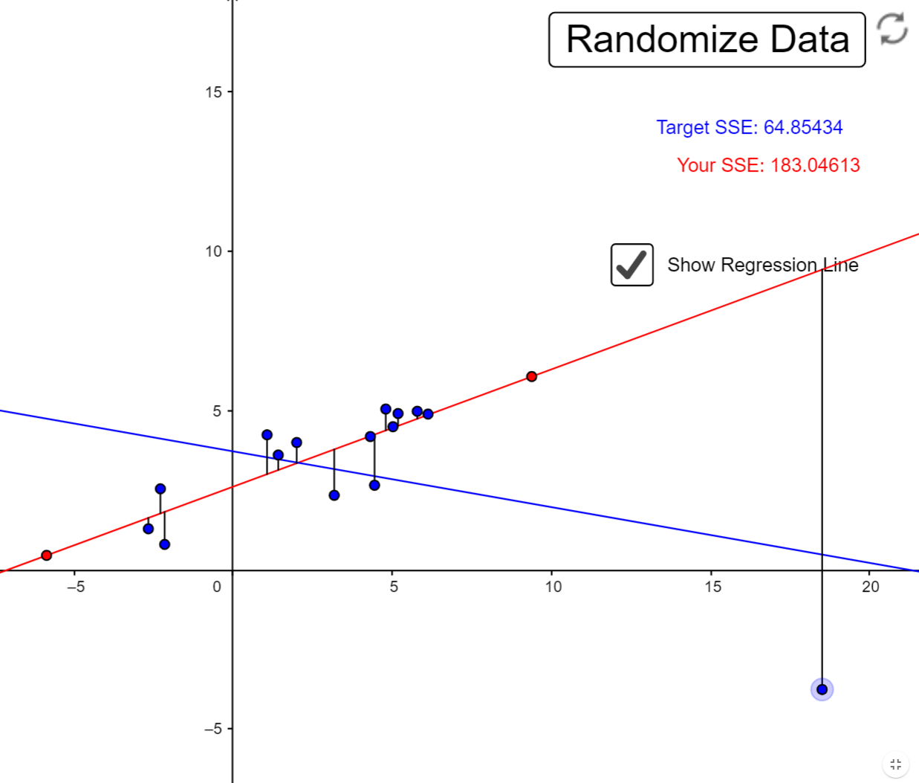
Robustness of Ordinary Least Squares (OLS)
Minimizing sum of squared error is very sensitive to outliers.
Probabilistic view: very little density in the tails of Gaussians.
https://www.geogebra.org/m/xC6zq7Zv

Slide 19
In general, how many serious outliers are necessary to
alter the solution to least-squares linear regression?
20% of the dataset
5% of the data
A single example if its bad enough
>50% of the dataset

Slide 20
Be able to answer:
Wrapping up a few details about OLS.
How can we use least-squares regression to fit more complex functions?
What is polynomial regression?
More generally, how can we learn linear functions over basis functions?
What is regularization?

Slide 21
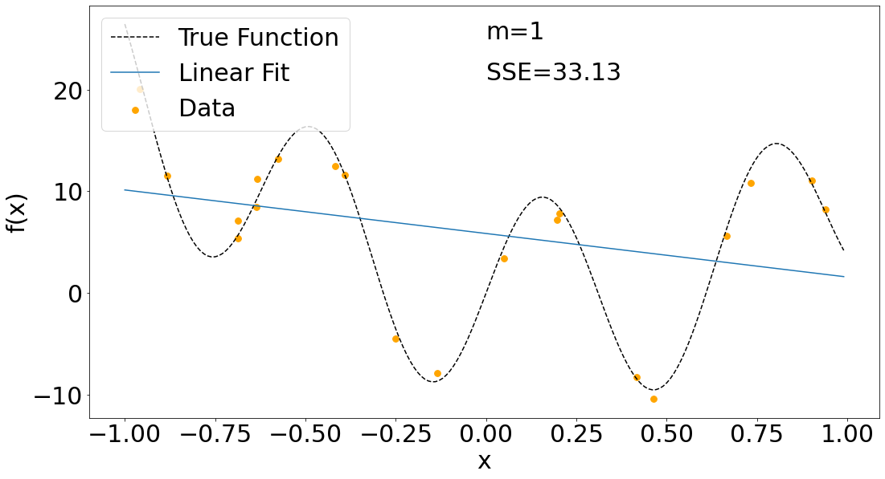
Beyond Lines but Still Linear?
Fitting lines seems cool but many, many functions of interest aren’t lines.

Slide 22
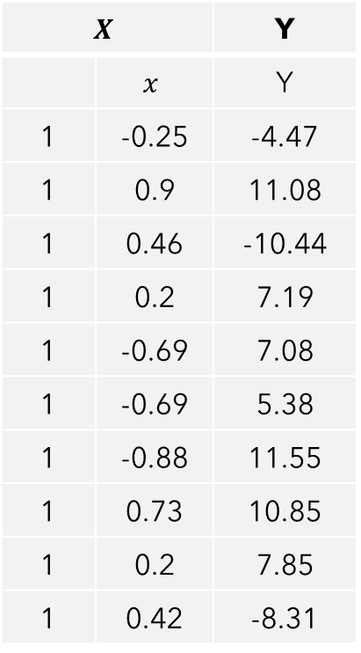
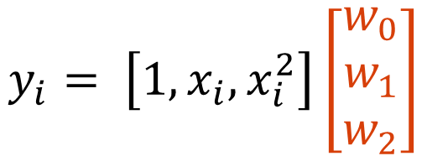
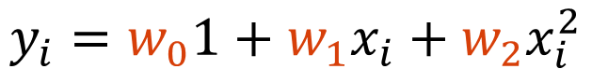
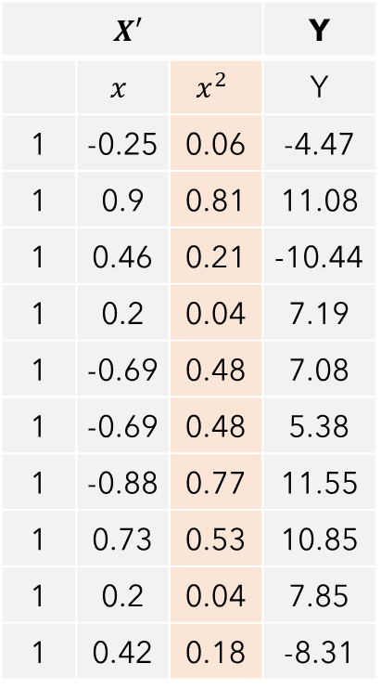
Beyond Lines but Still Linear?
Idea: Solve a linear regression problem in a feature space that is non-linear in the original input! For example, could add a $x^{2}$ term.
$$X$$ | X | Y
 | $$x$$ | Y
1 | -0.25 | -4.47
1 | 0.9 | 11.08
1 | 0.46 | -10.44
1 | 0.2 | 7.19
1 | -0.69 | 7.08
1 | -0.69 | 5.38
1 | -0.88 | 11.55
1 | 0.73 | 10.85
1 | 0.2 | 7.85
1 | 0.42 | -8.31
$$X′$$ | X |  | Y
 | $$x$$ | $$x^{2}$$ | Y
1 | -0.25 | 0.06 | -4.47
1 | 0.9 | 0.81 | 11.08
1 | 0.46 | 0.21 | -10.44
1 | 0.2 | 0.04 | 7.19
1 | -0.69 | 0.48 | 7.08
1 | -0.69 | 0.48 | 5.38
1 | -0.88 | 0.77 | 11.55
1 | 0.73 | 0.53 | 10.85
1 | 0.2 | 0.04 | 7.85
1 | 0.42 | 0.18 | -8.31
Solve for w such that:
$$y_{i}=w_{0}1+w_{1}x_{i}+w_{2}x_{i}^{2}$$
Linear function of non-linear transformations of x
$$y_{i}= \left[1, x_{i},x_{i}^{2}\right]\left[\begin{matrix}w_{0} \\ w_{1} \\ w_{2}\end{matrix}\right]$$

Slide 23
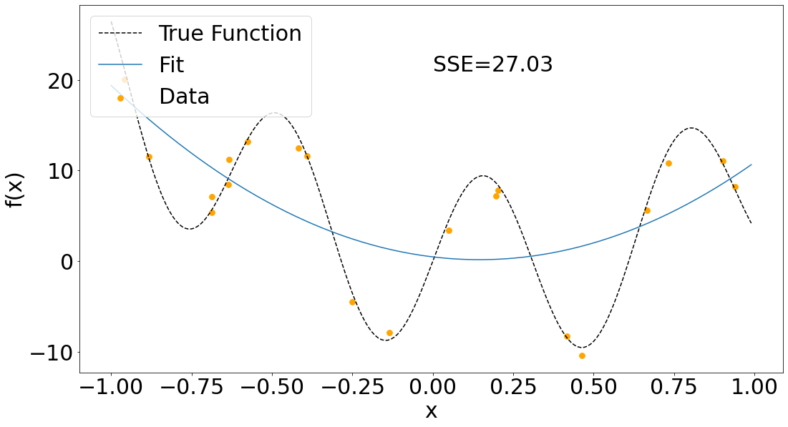
Beyond Lines but Still Linear?

Slide 24
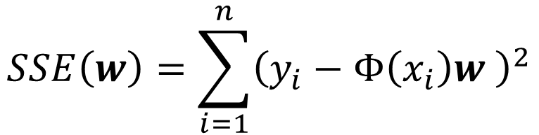
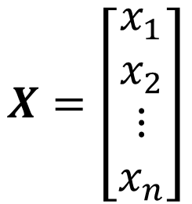
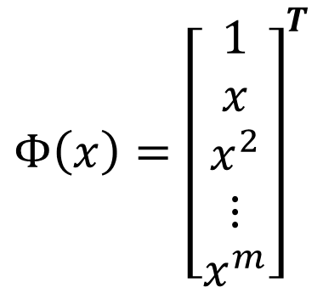
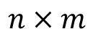
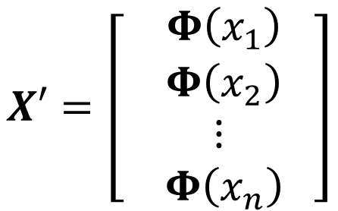
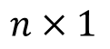
Polynomial Regression
More general example: m-order polynomial regression in the 1d case.
$$Φ\left(x\right)={\left[\begin{aligned}1 \\ x \\ x^{2} \\ ⋮ \\ x^{m}\end{aligned}\right]}^{T}$$
$$X=\left[\begin{aligned}x_{1} \\ x_{2} \\ ⋮ \\ x_{n}\end{aligned}\right]$$
$$X′=\left[\begin{aligned} Φ\left(x_{1}\right) \\ Φ\left(x_{2}\right) \\ ⋮ \\ Φ\left(x_{n}\right) \end{aligned}\right]$$
$$n×1$$
$$n×m$$
Want to find a weight vector w such that the sum of squared error is minimized:
$$SSE\left(w\right)=\sum_{i=1}^{n}{{\left(y_{i}−Φ\left(x_{i}\right)w \right)}^{2}}$$
$$⟹w^{∗}={X^{′}}^{+}y$$

Slide 25
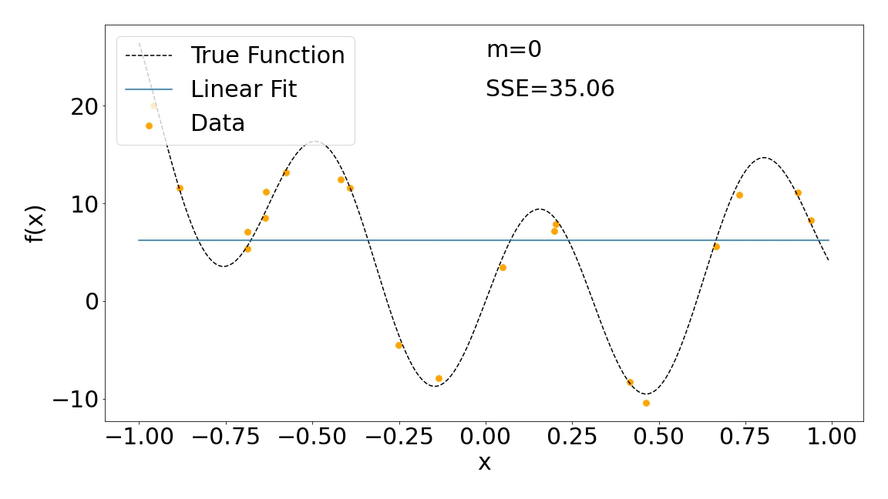
Polynomial Regression
Number of data points n=20

Slide 26
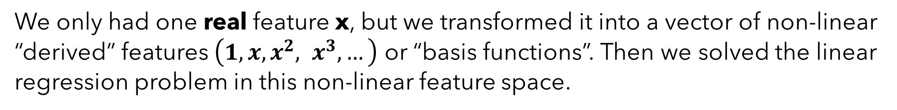
Polynomial Regression
What just happened? (Ignore the overfitting at the end for now)
We only had one real feature x, but we transformed it into a vector of non-linear “derived” features $\left(1,x,x^{2}, x^{3},…\right)$ or “basis functions”. Then we solved the linear regression problem in this non-linear feature space.
To predict y for a new point x, just do $φ\left(x\right)w$!
What about when the input features are already multidimensional?

Slide 27
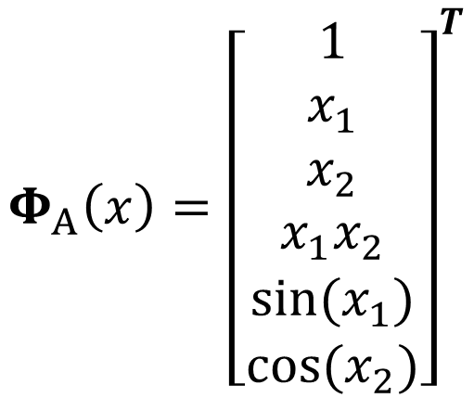
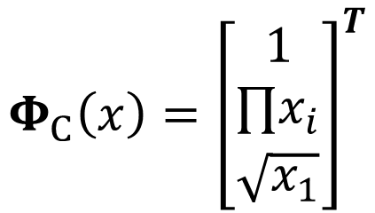
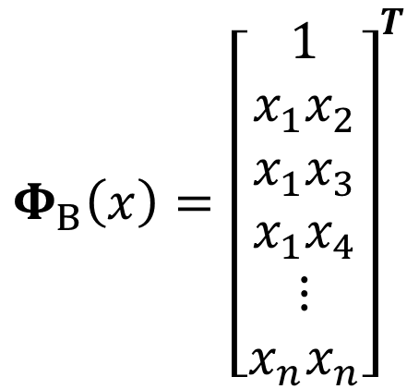
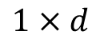
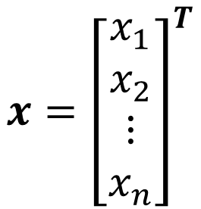
Linear Regression over Basis Functions
Let’s generalize this further.
Each data point has $d$ features. Let $Φ: ℝ^{d}→ℝ^{d^{′}}$ be our basis function. Can make any arbitrary choice we want here based on how the data looks.
$$Φ_{A}\left(x\right)={\left[\begin{aligned}1 \\ x_{1} \\ x_{2} \\ x_{1}x_{2} \\ sin⁡(x_{1}) \\ cos⁡(x_{2})\end{aligned}\right]}^{T}$$
$$Φ_{B}\left(x\right)={\left[\begin{aligned}1 \\ x_{1}x_{2} \\ x_{1}x_{3} \\ x_{1}x_{4} \\ ⋮ \\ x_{n}x_{n}\end{aligned}\right]}^{T}$$
$$x={\left[\begin{aligned}x_{1} \\ x_{2} \\ ⋮ \\ x_{n}\end{aligned}\right]}^{T}$$
$$Φ_{C}\left(x\right)={\left[\begin{aligned}\begin{aligned}1 \\ ∏x_{i}\end{aligned} \\ \sqrt{x_{1}}\end{aligned}\right]}^{T}$$
$$1×d$$
No matter what we choose, the procedure is the same. Replace each $x$ (row) in our data matrix with $Φ\left(x\right)$, then solve the linear regression problem.

Slide 28
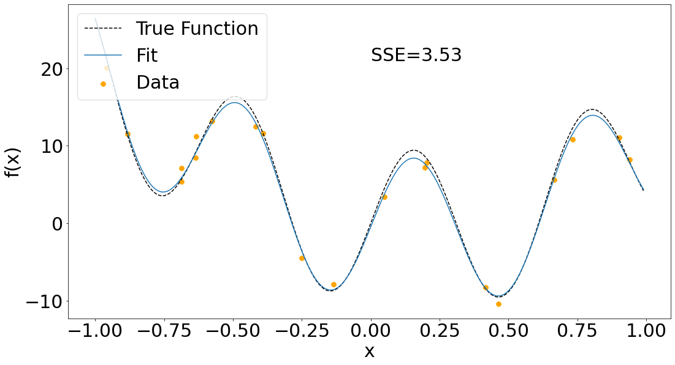
Linear Regression over Basis Functions
$Φ\left(x\right)=$ $\left[\begin{matrix}\begin{matrix}1 & x\end{matrix} & \begin{matrix}x^{2} & sin(10x)\end{matrix}\end{matrix}\right]$

Slide 29
Summary of Linear Regression over Basis Functions
Recap:
Linear regression over non-linear basis functions of x results in fitting non-linear functions of x!
Pros:
Super simple to implement.
Can easily add more basis functions.
Can be solved exactly.
Cons:
We need some intuitions from the data about what basis function to use.
Each basis function we add increases the number of columns in our data matrix – we may not have enough data to fit such a complex function!
Easy to overfit if our basis gets too big.

Slide 30
Be able to answer:
Wrapping up a few details about OLS.
How can we use least-squares regression to fit more complex functions?
What is polynomial regression?
More generally, how can we learn linear functions over basis functions?
What is regularization?
What is logistic regression?

Slide 31
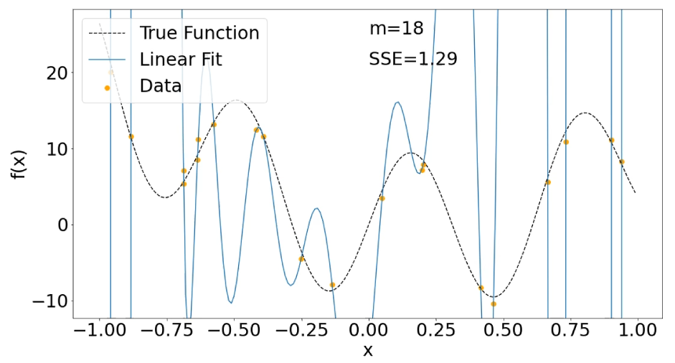
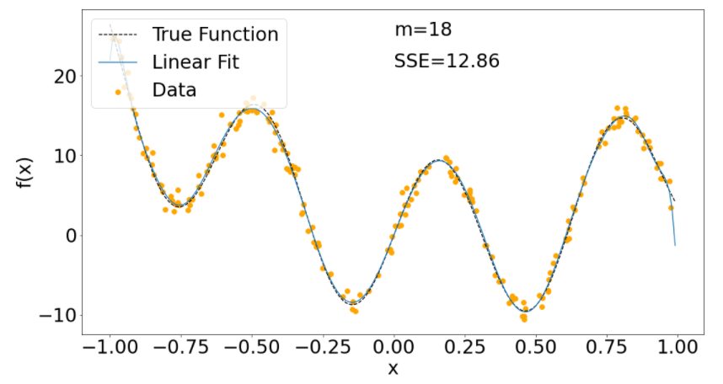
Techniques for Avoiding Overfitting
What can we do to reduce overfitting?
View it as an estimation error
Solution: Get more data
Do model selection to find a simpler model
Less complicated model, less data needed.
Regularization
Add a prior belief that the model should be simple!
Okay. But how to encode this?

Slide 32
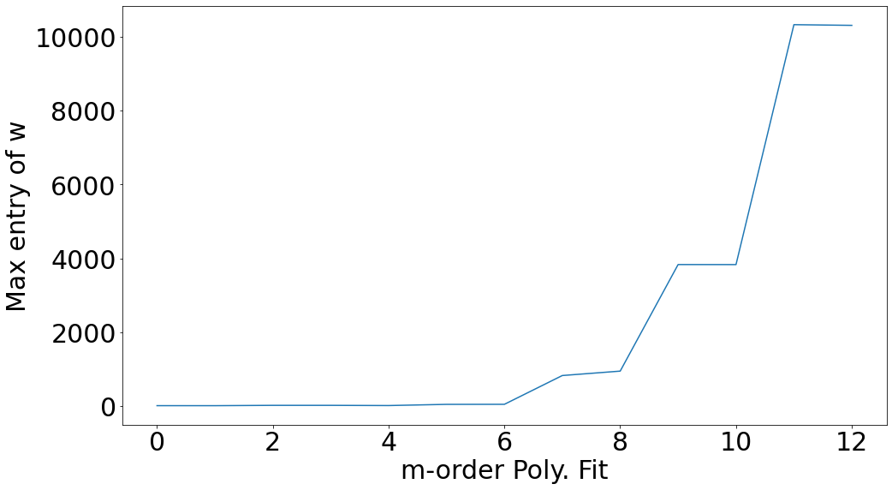
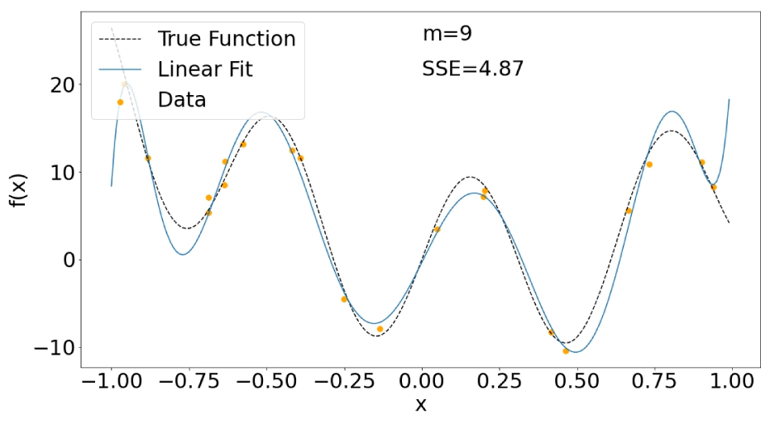
Characterizing Overfitting in Linear Models
In linear models, overfitting can often by characterized by large weights.

Slide 33
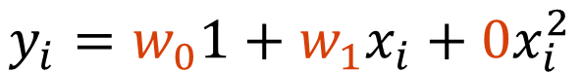
Characterizing Overfitting in Linear Models
Intuition 1:
With large weights, small changes in input may result in large output changes.
Intuition 2:
If I set weights to (nearly) zero, I’m dropping dimensionality.
$$y_{i}=w_{0}1+w_{1}x_{i}+0x_{i}^{2}$$
Zero-valued weights reduce the complexity of our model.

Slide 34

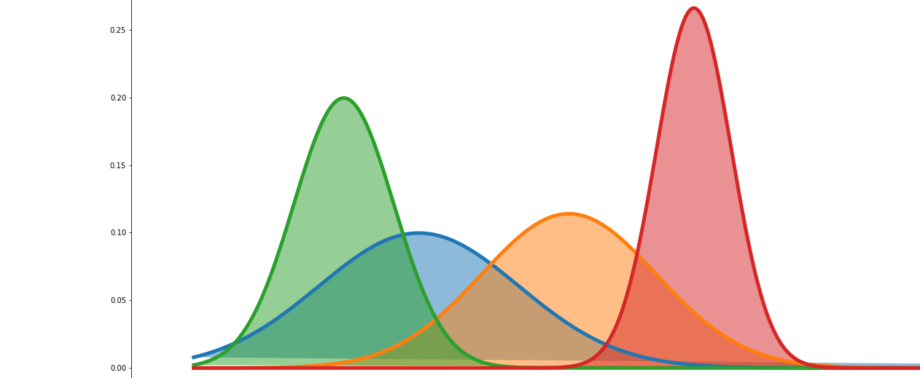
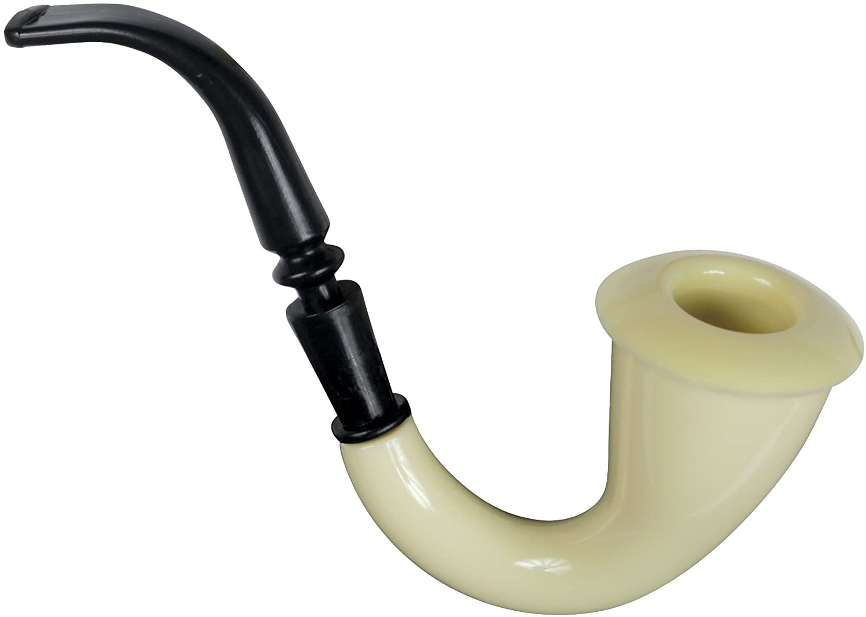
Regularization by Pushing Weights Towards Zero
Seems like a useful prior belief would be that weights should be relatively small while still fitting the data well -- with some tradeoff between the two.
If only we had learned about a rigorous framework for reasoning about prior beliefs….

Slide 35


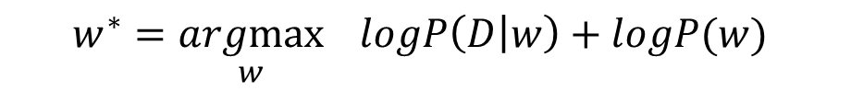
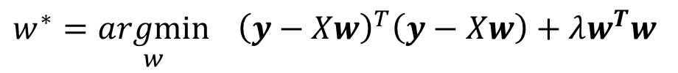
L2 Regularization
Regularizer View
Bayesian View
Add a regularization penalty $λw^{T}w$ to the SSE
Assume a Gaussian prior
$$w∼𝒩\left(\vec{0}, βI\right)$$
$$w^{∗}=\underset{w}{argmin}{ {\left(y−Xw\right)}^{T}\left(y−Xw\right)+λw^{T}w}$$
$$w^{∗}=\underset{w}{argmax}{ logP\left(D | w\right)+logP(w)}$$
Arrive at the same solution.

Slide 36
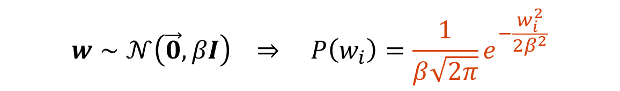
L2 Regularization – The Bayesian View
Dataset: Given a dataset $D={\left\{(x_{i},y_{i})\right\}}_{i=1}^{N}$ assume the above conditional probability.
Model assumptions:
$$y_{i}=w^{T}x_{i}+𝒩\left(0,σ\right) ⟹P\left(y_{i} | x_{i}, w\right)=𝒩\left(w^{T}x_{i},σ\right)$$
$$w∼𝒩\left(\vec{0}, βI\right) ⇒ P\left(w_{i}\right)=\frac{1}{β\sqrt{2π}}e^{−\frac{w_{i}^{2}}{{2β}^{2}}}$$
Write out posterior of the training data as a function of parameters:
$$P\left(w|D\right)∝P\left(D∣w\right)P(w)=P(w)\prod_{i=1}^{N}{P\left(y_{i} ∣ w\right)=\left(\prod_{j=1}^{d}{\frac{1}{β\sqrt{2π}}e^{−\frac{w_{j}^{2}}{2β^{2}}}}\right)\prod_{i=1}^{N}{\frac{1}{σ\sqrt{2π}}e^{−\frac{{\left(y_{i}−w^{T}x_{i}\right)}^{2}}{2σ^{2}}}}}$$

Slide 37

L2 Regularization – The Bayesian View
Write out posterior of the training data as a function of parameters:
$$P\left(w|D\right)∝P\left(D∣w\right)P(w)=P(w)\prod_{i=1}^{N}{P\left(y_{i} ∣ w\right)=\left(\prod_{j=1}^{d}{\frac{1}{β\sqrt{2π}}e^{−\frac{w_{j}^{2}}{2β^{2}}}}\right)\prod_{i=1}^{N}{\frac{1}{σ\sqrt{2π}}e^{−\frac{{\left(y_{i}−w^{T}x_{i}\right)}^{2}}{2σ^{2}}}}}$$
Take log of the posterior to clean things up:
$$logP(w|D)=−\frac{1}{{2β}^{2}}\sum_{j=1}^{d}{w_{j}^{2}}−\frac{1}{2σ^{2}}\sum_{i=1}^{N}{{\left(y_{i}−w^{T}x_{i}\right)}^{2}}+…$$
$$=−\frac{1}{{2β}^{2}}w^{T}w−\frac{1}{2σ^{2}}{\left(y−Xw\right)}^{T}\left(y−Xw\right)+…$$
Vectorizing stuff:

Slide 38
L2 Regularization
Regularizer View
Bayesian View
Add a regularization penalty $λw^{T}w$ to the SSE
Assume a Gaussian prior
$$w∼𝒩\left(\vec{0}, βI\right)$$
$$w^{∗}=\underset{w}{argmin}{ {\left(y−Xw\right)}^{T}\left(y−Xw\right)+λw^{T}w}$$
$$w^{∗}=\underset{w}{argmax}{ logP\left(D | w\right)+logP(w)}$$
Arrive at the same solution for L2 regularized least squares.
$$w^{∗}={\left(X^{T}X+λI\right)}^{−1}X^{T}y$$

Slide 39



Effect of Regularization – Example 1
$$w^{∗}=\underset{w}{argmin}{ {\left(y−Xw\right)}^{T}\left(y−Xw\right)+λw^{T}w}$$
$$w^{∗}={\left(X^{T}X+λI\right)}^{−1}X^{T}y$$

Slide 40

Given that L2 regularized least squares solves the following:
$$w^{∗}=\underset{w}{argmin}{ {\left(y−Xw\right)}^{T}\left(y−Xw\right)+λw^{T}w}$$
As $λ$ gets very large, the error on the training set approaches $y^{T}y$
True and I understand why
False and I understand why
True but I’m not sure why
False but I’m not sure why

Slide 41

Overregularized models may underfit

Slide 42




Effect of Regularization – Example 2
Each red line is the result of a 9th degree polynomial fit on 10 random points noisily sampled from the true curve.
$$λ≈13.46$$
$$λ≈0.73$$
$$λ≈0.09$$
Smaller $λ$ resulted in more complex curves that better fit the data but has a high variance.

Slide 43



Effect of Regularization – Example 2
Consider regularization (or priors in general) as trading off between bias and variance.
No or low regularization has low bias, but high variance.
Highly regularized models have high bias, but low variance.
Often referred to as a “bias-variance tradeoff”.
$$λ≈13.46$$
$$λ≈0.73$$
$$λ≈0.09$$

Slide 44


Other forms of Regularization
Could consider a whole family of regularization techniques based on different norms.
$$w^{∗}=\underset{w}{argmin}{ {\left(y−Xw\right)}^{T}\left(y−Xw\right)+λ{\left\|w\right\|}_{p}^{p}}$$
$${\left\|w\right\|}_{p}^{p}=\sum_{i=1}^{d}{{\left|x_{i}\right|}^{p}}$$
Just Minkowski norm raised to power p
where
Equivalent to minimizing the sum of squared error (SSE) subject to constraint (proof):
${\left\|w\right\|}_{p}^{p}≤ε$ for some constant $ε$

Slide 45


Other forms of Regularization
Suggests regularization constrains solutions to be within some distance of the origin:
${\left\|w\right\|}_{p}^{p}≤ε$ for some constant $ε$
$p$ defines the shape of the region of viable solutions, $λ$ determines its size

Slide 46
Common forms of regularization in linear regression
Ridge Regression – The L2 penalized least-squares objective we’ve been dealing with so far.
Lasso Regression - Penalizes the L1-norm of the weights (i.e. minimizing sum of absolute value of weights).
L0 or Sparse Regression- Penalizes the number of non-zero weights. This requires combinatoric optimization to solve exactly – NP-complete problem!

Slide 47

L2 vs L1 Regularization
Ridge Regression (L2)
Lasso Regression (L1)
Tends to yield denser weights
Tends to yield sparser weights
Computationally easy
More computationally involved

Slide 48
Summary of Regularization
Regularization is a much more general concept in machine learning. Consider any learning task to minimize a loss $ℒ(w)$ on the training data – could add a regularizer term.
$$w^{∗}=\underset{w}{argmin}{ℒ\left(w\right)+λ∗regularizer(w)}$$
Generally speaking, larger $λ′s$ lead to simpler models and reduce overfitting, smaller $λ^{′}s$ lead to more complex models but improve fit on training data.
Most commonly used regularizers are based on the norm of the weight vector.

Slide 49
Be able to answer:
Wrapping up a few details about OLS.
How can we use least-squares regression to fit more complex functions?
What is polynomial regression?
More generally, how can we learn linear functions over basis functions?
What is regularization?
What is logistic regression?

Slide 50
Logistic Regression
Moving onto a new topic. Binary classification with logistic regression.
Binary (or two class) classification means our output y should be 0 or 1.
Logistic Regression Idea: Assume the probability of a data point x belonging to class 1 can be predicted by a warping the output of a linear model to be between 0 and 1.
Logistic regression is a “linear classifier” because it will only be able to represent linear decision boundaries.

Slide 51

Why not regress probabilities directly?
Consider trying to regress a probability directly:
$$e.g., P\left(y_{i} | x_{i};w\right)=w^{T}x$$
Some issues:
Nothing constrains the output to be $0≤P\left(y_{i} | x_{i};w\right)≤1$
Nothing constraints $P\left(y_{i}=1 | x_{i};w\right)+P\left(y_{i}=0 | x_{i};w\right)=1$
Want something that “forces” it to the range 0-1…

Slide 52



Why not regress probabilities directly?
Introducing the logistic function:
May also see it referred to as a sigmoid function or “logit” function
Logistic Function $σ\left(z\right)=\frac{1}{1+e^{−z}}$
Maps $(−∞, ∞)$ to $(0,1)$

Slide 53

Logistic Regression
Logistic Regression Model Assumption:
$$P\left(y_{i}=1 | x_{i};w\right)=σ\left(w^{T}x_{i}\right)=\frac{1}{1+e^{−w^{T}x_{i}}}$$
$$P\left(y_{i}=0 | x_{i};w\right)=1−σ\left(w^{T}x_{i}\right)=\frac{e^{−w^{T}x_{i}}}{1+e^{−w^{T}x_{i}}}$$

Slide 54





Logistic Regression
Logistic Regression Model’s Decision Boundary:
Predict $1$ if
$$P\left(y_{i}=1 | x_{i};w\right)>P(y_{i}=0|x_{i};w)$$
$$⇒ \frac{P\left(y_{i}=1 | x_{i};w\right)}{P(y_{i}=0|x_{i};w)} > 1$$
Divide both sides by $P(y_{i}=0|x_{i};w)$
$$⇒ e^{w^{T}x} > 1$$
Just some algebra
This tells us the decision boundary is the line $w^{T}x=0$
Log of both sides
$$⇒ w^{T}x >0$$

Slide 55

Logistic Regression
Example logistic regression decision boundary – linear in the features.

Slide 56


Intuition for Logistic Regression in 2D
$$σ\left(b+w^{T}x\right)=\frac{1}{1+e^{−(w^{T}x+b)}}$$
$$w$$
$$w={\left[10, 5\right]}^{T}$$
$$b$$
$$b=−1$$
$$\left|w\right|$$

Slide 57

Intuition for Logistic Regression in 2D
$$σ\left(b+w^{T}x\right)=\frac{1}{1+e^{−(w^{T}x+b)}}$$
$$w={\left[10, 5\right]}^{T}$$
$$b$$
$$b=15$$

Slide 58

Intuition for Logistic Regression in 2D
$$σ\left(b+w^{T}x\right)=\frac{1}{1+e^{−(w^{T}x+b)}}$$
$$w$$
$$w={\left[−7, 5\right]}^{T}$$
$$b=15$$

Slide 59

Intuition for Logistic Regression in 2D
$$σ\left(b+w^{T}x\right)=\frac{1}{1+e^{−(w^{T}x+b)}}$$
$$w={\left[−70, 50\right]}^{T}$$
$$b=150$$
$$\left|w\right|$$

Slide 60

MLE for Logistic Regression
Dataset: Given a dataset $D={\left\{(x_{i},y_{i})\right\}}_{i=1}^{N}$
Model assumptions:
$$y_{i}∼Bernoulli\left(θ=σ\left(w^{T}x_{i}\right)\right)$$
$$⇒P\left(y_{i} | x_{i},w\right)= σ{\left(w^{T}x_{i}\right)}^{y_{i}}{\left(1−σ\left(w^{T}x_{i}\right)\right)}^{(1−y_{i})}$$
Write out log-likelihood of the training data as a function of parameters:
$$logP\left(D∣w\right)=\sum_{i=1}^{N}{logP(y_{i}|x_{i}, w)}=\sum_{i=1}^{N}{y_{i}\log{σ\left(w^{T}x_{i}\right)}+{(1−y}_{i})\log\left(1−σ\left(w^{T}x_{i}\right)\right)}$$
Finding the best weights comes down to maximizing this (or equivalently minimizing the negative log-likelihood).

Slide 61

MLE for Logistic Regression
Let’s consider the negative log likelihood instead (convenient for later)
$$−logP\left(D∣w\right)=\sum_{i=1}^{N}{\left(−y_{i}\log{σ\left(w^{T}x_{i}\right)}−{(1−y}_{i})\log\left(1−σ\left(w^{T}x_{i}\right)\right)\right)}$$
$$=\sum_{i=1}^{N}{l_{i}}$$
Where $l_{i}=\left(−y_{i}\log{σ\left(w^{T}x_{i}\right)}−{(1−y}_{i})\log\left(1−σ\left(w^{T}x_{i}\right)\right)\right)$
We usually take derivatives and set to zero to find the minimum:
$$−∇logP\left(D∣w\right)=\sum_{i=1}^{N}{∇l_{i}}$$
No closed form solution in this case. Let’s see why.

Slide 62

MLE for Logistic Regression
Let’s focus in on just the loss of a particular example:
$${∇l}_{i}=∇\left(−y_{i}\log{σ\left(w^{T}x_{i}\right)}−{(1−y}_{i})\log\left(1−σ\left(w^{T}x_{i}\right)\right)\right)$$
$$=−y_{i}∇log{σ\left(w^{T}x_{i}\right)}−{(1−y}_{i})∇log\left(1−σ\left(w^{T}x_{i}\right)\right)$$
$$=\left(−\frac{y_{i}}{σ\left(w^{T}x_{i}\right)}−\frac{1−y_{i}}{1−σ\left(w^{T}x_{i}\right)}\right)∇σ\left(w^{T}x_{i}\right)$$
Gradient of the logistic function $∇σ\left(z\right)=σ\left(z\right)\left(1−σ\left(z\right)\right)$, so $∇σ\left(w^{T}x_{i}\right)=σ\left(w^{T}x_{i}\right)\left(1−σ\left(w^{T}x_{i}\right)\right)x_{i}$
$${∇l}_{i}=\left(−\frac{y_{i}}{σ\left(w^{T}x_{i}\right)}−\frac{1−y_{i}}{1−σ\left(w^{T}x_{i}\right)}\right)σ\left(w^{T}x_{i}\right)\left(1−σ\left(w^{T}x_{i}\right)\right)x_{i}$$
$$=\left(σ\left(w^{T}x_{i}\right)−y_{i}\right)x_{i}$$
Gradient is non-linear in parameters

Slide 63

Derivation of Derivative of Logistic Function

Slide 64
MLE for Logistic Regression
So we have an expression for the gradient but can’t find the optimal analytically…
$$∇−logP\left(D∣w\right)=\sum_{i=1}^{N}{∇l_{i}}=\sum_{i=1}^{N}{\left(σ\left(w^{T}x_{i}\right)−y_{i}\right)x_{i}}$$
Idea: The gradient points in the direction of steepest ascent of the function from a point.
Can we use that to find the minimum of a function?
Start with a random set of weights and iteratively move the parameters in the opposite direction of the gradient
This is referred to as gradient descent and is a first-order optimization method!

Slide 65
Gradient Descent

Slide 66



An Aside to Understand Gradient Descent
Given a function $ℒ:w→ ℝ$, find the minimum value. You can think of it as “loss surface” – for each setting of inputs, there is some function value.
Goal: Find a setting of w that has as low of loss as possible.
Recall: Gradient (vector of partial derivatives) point in the direction of steepest ascent.
Gradient Descent Algorithm
$$w←random\left(\right) \\ while{\left|∇_{w}ℒ\right|}_{2}>ε or iters remain \\ w=w−α∇_{w}ℒ(w)$$
Learning Rate / Step Size

Slide 67


An Aside to Understand Gradient Descent
Different starting points may lead to different local minima if the function being optimized is non-convex.
Gradient Descent Algorithm
$$w←random\left(\right) \\ while{\left|∇_{w}ℒ\right|}_{2}>ε or iters remain \\ w=w−α∇_{w}ℒ(w)$$
Learning Rate / Step Size

Slide 68


An Aside to Understand Gradient Descent
Choice of learning rate matters a lot. Usually good to decay it over time.
Gradient Descent Algorithm
$$w←random\left(\right) \\ while\left|∇_{w}ℒ\right|>ε or iters remain \\ w=w−α∇_{w}ℒ(w)$$
Learning Rate / Step Size

Slide 69
Gradient Descent

Slide 70

MLE for Logistic Regression
So we have an expression for the gradient but can’t find the optimal analytically…
$$∇−logP\left(D∣w\right)=\sum_{i=1}^{N}{∇l_{i}}=\sum_{i=1}^{N}{\left(σ\left(w^{T}x_{i}\right)−y_{i}\right)x_{i}}$$
Gradient Descent Algorithm for Logistic Regression
w = random(d) // randomly initialize weight vector
Repeat:
for each example $x_{i}, y_{i}∈D$: // compute gradient
${\hat{y}}_{i}=\frac{1}{1+e^{−w^{T}x_{i}}}$ // compute the prediction for this point
$∇+=\left({\hat{y}}_{i}−y_{i}\right)x_{i}$ // compute gradient of loss of point and sum
$w=w−α∇$ // take a step in the opposite direction of gradient
Until $\left|∇\right|≤ε$ // keep taking steps until convergence

Slide 71

An example of Logistic Regression with Gradient Descent

Slide 72

Summary of Logistic Regression
Logistic regression uses $σ\left(⋅\right)$ to warp the output of a linear function to (0,1), which is interpreted as $P(y=1|x;w)$
Learns a vector 𝒘 s.t. for input $x_{i}$ the desired correct output $y_{i}$ has high probability, and other incorrect outputs have low probabilities.
Maximize the log likelihood or minimize the negative log likelihood
Learn $w$ iteratively using gradient descent
Compute gradient and take a step in the opposite direction
Give minima when function is convex, otherwise local minima
Logistic regression learns a linear decision boundaries
Can apply the same basis function trick as in linear regression to learn nonlinear boundaries

Slide 73


Drawing a Parallel Between Linear Regression and Logistic Regression
Recall the model assumptions for linear regression and logistic regression:
$$y_{i}∼𝒩\left(μ=w^{T}x_{i},σ\right)$$
$$y_{i}∼Bernoulli\left(θ=σ\left(w^{T}x_{i}\right)\right)$$
Both model y coming from some probability distribution with parameters derived from some function of x. This is a very general notion.
$$y_{i}∼Categorical\left(θ_{c}=σ\left(w_{c}^{T}x_{i}\right)\right)$$

Slide 74
Next time
Next Time: We’ll talk about the perceptron algorithm (a very close neighbor to logistic regression) and then move on to Naïve Bayes.

